Slide 1
Degenerate Fermi Gas
Now we know how to calculate $\overline{n}$, mean number of occupants in a single-particle state for both types of particles – Fermions and Bosons, in terms of $ε, μ \& T$
But, to apply this idea to a particular system, we still need the energies of all the microstates of all that system.
The problem of Quantum Mechanics
This question can become extremely difficult in many cases.
Mostly, we consider a particle in a box, where quantum wave functions are simple, and corresponding energies can be found relatively easily
Particles can be, for example, electrons in a metal, neutrons in a neutron star, atoms in a fluid at low temperature, photons inside a hot oven or phonons
A phonon is a quantized unit of vibrational energy in a solid
1st thing we need is $μ$
so that we can decide if particles are Fermions or Bosons
An important application of quantum mechanics and Fermi-Dirac statistics is
Degenerate Fermi Gas

Slide 2
Degenerate Fermi Gas Cont.
FD statistics is applicable
Consider a gas of Fermions at very low temperature
Best example is “conduction electrons inside a chunk of metal at low temperature
$$V_{Q}={\left(\frac{h^{2}}{2πmk_{B}T}\right)}^{3/2}=65 {nm}^{3}$$
Fora typical metal, assuming one conduction electron from each atom,
$$\frac{V}{N}\sim 0.008 {nm}^{3}$$
Condition $\frac{V}{N}≪V_{Q}$
We can say “we have quantum gas of fermions
Suppose $T→0$ ➔ $ε=μ(T=0)$
Called Fermi energy, $ε_{F}$
When Fermion gas is cold, all states below $ε_{F}$ are occupied and all states above $ε_{F}$ are unoccupied
$$\overline{n}= \begin{matrix}1 ε<μ \\ 0 ε>μ\end{matrix}$$
A step function
Fermions gas is said to be degenerate
This has nothing to do with splitting of energy level which is also called degeneracy of energy level
To find $ε_{F}$, we need total number of fermions (electrons)

Slide 3
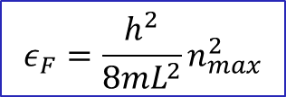
Degenerate Fermi Gas Cont.
Imagine an empty cubical box and start adding electrons into it one by one at a time
Each electron will go to lowest energy state available below $ε_{F}$
To add more electrons, you need to give an electron the energy dU, $μ=ε_{F}$
We know $μ=\frac{dU}{dN}$ (at constant S and V)
$dN=1$ ➔ $dU=μ$
Assuming electrons are free particles and there is no external force (infect, there will be electrostatic force due to + ions), electrons are confined to volume, $V=L^{3}$
We need to define energy wave function of a free electron in a box
In 1-dimensional box, we know $ε_{n}=\frac{h^{2}n^{2}}{8mL^{2}}$ (standing waves on a string)
$$ε_{n}=\frac{h^{2}}{8mL^{2}}\left(n_{x}^{2}+n_{y}^{2}+n_{z}^{2}\right)$$
n is positive integer
In 3-dimensional box, we will have
When electrons a re added, they settle in $\frac{1}{8}$ (a sphere of radius $n_{max}$)
$$n_{z}$$
$$ε_{F}=\frac{h^{2}}{8mL^{2}}n_{max}^{2}$$
$ε_{F}$ is energy of the state at the surface of a sphere – Fermi surface
$$n_{y}$$
$$ε_{F}=μ(T→0)$$
$$n_{x}$$

Slide 4
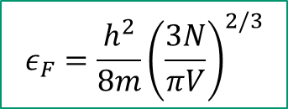
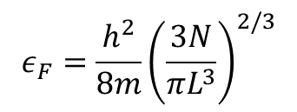
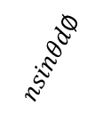
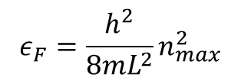
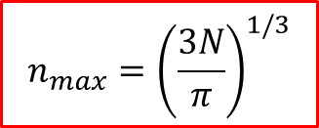
Degenerate Fermi Gas Cont.
$$N=\frac{1}{8}\left(\frac{3}{4}πn_{max}^{3}\right)$$
But electrons have spin – 2 spin states for each particle)
Total number of particles,
$N=\frac{1}{4}\left(\frac{3}{4}πn_{max}^{3}\right)=\frac{π}{3}$ $n_{max}^{3}$
$$n_{max}={\left(\frac{3N}{π}\right)}^{1/3}$$
$$OR$$
$$ε_{F}=\frac{h^{2}}{8mL^{2}}n_{max}^{2}$$
$$ε_{F}=\frac{h^{2}}{8m}{\left(\frac{3N}{πL^{3}}\right)}^{2/3}$$
$$ε_{F}=\frac{h^{2}}{8m}{\left(\frac{3N}{πV}\right)}^{2/3}$$
The energy
$$U=2\sum_{n_{x}}{}\sum_{n_{y}}{}\sum_{n_{z}}{ε(n)}$$
ndθ
Since sum is huge
$$U=2\iiint{ε\left(n\right)dn_{x}dn_{y}dn_{z}}$$
$$n_{z}$$
dn
$$θ$$
n
$$nsinθd∅$$
In spherical coordinate $\left(n, θ, ∅\right)$
$$n_{y}$$
$$∅$$
$$U=2\int_{0}^{n_{max}}{dn}\int_{0}^{\frac{π}{2}}{dθ}\int_{0}^{\frac{π}{2}}{d∅\left(n^{2}sinθ\right)ε(n)}$$
$$n_{x}$$
$$n=\sqrt{n_{x}^{2}+n_{y}^{2}+n_{z}^{2}}$$
$$dV=(dn)(ndθ)(nsinθd∅)$$

Slide 5
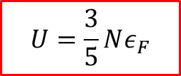
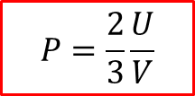
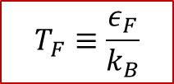
Degenerate Fermi Gas Cont.
$$U=2\int_{0}^{n_{max}}{dn}\int_{0}^{\frac{π}{2}}{dθ}\int_{0}^{\frac{π}{2}}{d∅\left(n^{2}sinθ\right)ε(n)}$$
$$=\frac{πh^{2}}{8mL^{2}}\left(\frac{n_{max}^{5}}{5}\right)$$
➔ $=\frac{3}{5}N\left(\frac{h^{2}}{8m}\right){\left(\frac{3N}{πV}\right)}^{2/3}$
$$U=\frac{3}{5}Nε_{F}$$
Average energy of a particle
$\overline{ε}=\frac{3}{5}$ $ε_{F}$
As thermal energy is $k_{B}T$
➔ $ε_{F}≫k_{B}T$
For a typical metal, $ε_{F}$ is few eV
${\text{And} \text{at} \text{room} \text{T} k}_{B}T\sim \frac{1}{40}eV$
Fermi Temperature,
$$T_{F}≡\frac{ε_{F}}{k_{B}}$$
As $P=−{\left(\frac{∂U}{∂V}\right)}_{S, N}$
➔ $P=−{\left(\frac{3}{5}\frac{∂Nε_{F}}{∂V}\right)}_{S, N}$
But $ε_{F}=\frac{h^{2}}{8m}{\left(\frac{3N}{πV}\right)}^{2/3}$
➔ $P=−\frac{3}{5}\frac{∂}{∂V}\left[\frac{3N}{5}\frac{h^{2}}{8m}{\left(\frac{3N}{π}\right)}^{2/3}V^{−2/3}\right]$
$$P=\frac{2}{3}\frac{U}{V}$$
Called Degeneracy
Pressure
Degeneracy pressure is responsible keeping matter from collapsing under huge electrostatic forces
It has nothing to do with electrostatic repulsive force. This is only due to Pauli Exclusion Principle

Slide 6
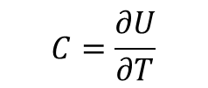
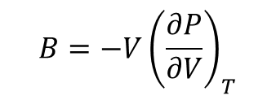
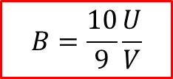
Degenerate Fermi Gas Cont.
$$B=−V{\left(\frac{∂P}{∂V}\right)}_{T}$$
Another measurable quantity is Bulk Modulus
$P=\frac{2}{3}\frac{U}{V}$
and $U=\frac{3}{5}N\left(\frac{h^{2}}{8m}\right){\left(\frac{3N}{πV}\right)}^{2/3}$
➔ $\frac{∂P}{∂V}=\frac{2}{3}\frac{∂}{∂V}\left(UV^{−1}\right)$
With some algebra ➔
$$B=\frac{10}{9}\frac{U}{V}$$
Heat Capacity
$$C=\frac{∂U}{∂T}$$
It can not be calculated under the assumption of T = 0
What happens when T is non-zero, still very low
At any temp, T
All particles have thermal energy $\sim k_{B}T$
But in a degenerate Fermi (electrons) gas, all energy states are already occupied ➔ most of the electrons can not acquire small energy, $k_{B}T$ since they can not jump to higher state (No vacancy)
$$\overline{n}$$
Only electrons close to Fermi surface (within energy $k_{B}T$ belwo $ε_{F}$) can acquire the energy and jump above Fermi surface
1
Number of electrons effected, $N_{eff}∝T$
T = 0 K
$$ε=μ$$
$$ε$$

Slide 7
Degenerate Fermi Gas Cont.
$$N_{eff}=N\frac{k_{B}T}{ε_{F}}$$
Therefore, the additional energy $∝N_{eff}k_{B}T OR Nk_{B}T\frac{k_{B}T}{ε_{F}}$
Additional energy $=\frac{π^{2}}{4}\frac{Nk_{B}^{2}T^{2}}{ε_{F}}$
➔ Total Thermal energy,
$$U=\frac{3}{5}Nε_{F}+\frac{π^{2}}{4}\frac{Nk_{B}^{2}T^{2}}{ε_{F}}$$
➔ $C_{V}={\left(\frac{∂U}{∂T}\right)}_{V}=\frac{π^{2}}{2}\frac{Nk_{B}^{2}T}{ε_{F}}$
The electronic contribution to heat capacity.
Lattice vibrations also contributes to C
Hence,
$T=0, C_{V}=0$ (3rd law of thermodynamics)
For low temperature, $T→0, C_{V}∝T$ (agrees with experimental data

Slide 8
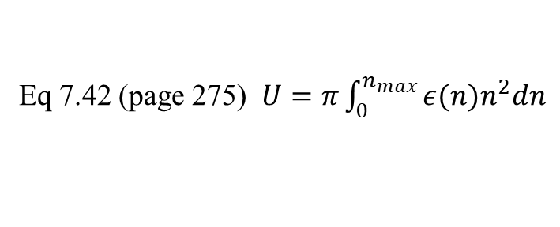
Density of state
Number of single-particle energy states per unit energy
$$ε_{n}=\frac{h^{2}n^{2}}{8mL^{2}}$$
We already have energy of a particle in a box
➔ $n={\left(\frac{8mL^{2}}{h^{2}}\right)}^{1/2}ε^{1/2}$
➔ $dn={\left(\frac{8mL^{2}}{h^{2}}\right)}^{1/2}\frac{dε}{2ε^{1/2}}$
Eq 7.42 (page 275) $U=π\int_{0}^{n_{max}}{ε(n)n^{2}dn}$
When $n→n_{max} , ε→ε_{F}$
$$U=π\int_{0}^{ε_{F}}{ε(n){{\left[{\left(\frac{8mL^{2}}{h^{2}}\right)}^{1/2}ε^{1/2}\right]}^{2}{\left(\frac{8mL^{2}}{h^{2}}\right)}^{1/2}\frac{dε}{2ε^{1/2}}}^{}}$$
$$U=\int_{0}^{ε_{F}}{ε {\frac{π}{2}\left(\frac{8mL^{2}}{h^{2}}\right)}^{3/2}ε^{1/2} dε}$$
Called Density of state, $g(ε)$
$$U=\int_{0}^{ε_{F}}{ε g\left(ε\right)dε}$$
$g\left(ε\right)={\frac{π}{2}\left(\frac{8mL^{2}}{h^{2}}\right)}^{3/2}$ $ε^{1/2}$

Slide 9
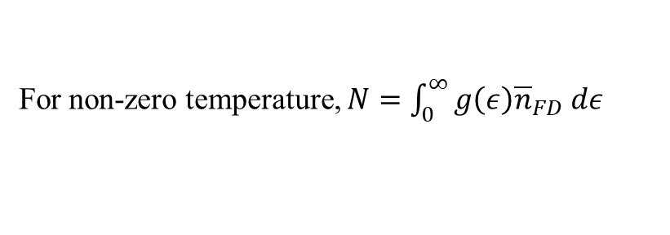
Density of state cont.
$$g\left(ε\right)={\frac{π}{2}\left(\frac{8m}{h^{2}}\right)}^{3/2}V ε^{1/2}$$
$g\left(ε\right)={\frac{π}{2}\left(\frac{8mL^{2}}{h^{2}}\right)}^{3/2}$ $ε^{1/2}$
OR $g\left(ε\right)=\frac{3N}{2ε_{F}^{3/2}} ε^{1/2}$
Note: $g\left(ε\right)$ does not depend on N, since N will cancel out when expression for $ε_{F}$ is plugged in
$g\left(ε\right)∝V$ and $g(ε)∝\sqrt{ε}$
If we want to find, total number of states available between $ε_{1} and ε_{2}$
$$N=\int_{ε_{1}}^{ε_{2}}{g\left(ε\right) n dε}$$
For Fermions, since n = 1 below $ε_{F}, N=\int_{ε_{1}=0}^{ε_{F}}{g\left(ε\right) dε}$
At T = 0
For non-zero temperature, $N=\int_{0}^{∞}{g\left(ε\right){\overline{n}}_{FD} dε}$
Fermi-Dirac distribution
$$N=\int_{0}^{∞}{g\left(ε\right)\frac{1}{e^{β(ε−μ)}+1} dε}$$
At any T
And
$$U=\int_{0}^{∞}{ε g\left(ε\right){\overline{n}}_{FD}dε}=\int_{0}^{∞}{g\left(ε\right)\frac{ε}{e^{β(ε−μ)}+1} dε}$$
Note:
At $T=0, {for ε<ε}_{F} {\overline{n}}_{FD}=1$
and ${for ε>ε}_{F} { \overline{n}}_{FD}=0$

Slide 10
Black Body Radiation
Another application of quantum statistics or grand canonical
Consider electromagnetic radiation inside a box at a given temperature
Classical Consideration
E M radiation are continuous field.
In a box, we can think of standing waves pattern. Each wave behaves as a hormonic oscillator with $f=\frac{c}{λ}$
Since EM radiation are transverse waves
➔ each standing wave has 2 degrees of freedom and each
➔ each has $\overline{E}=\frac{f}{2}k_{B}T=k_{B}T$
Since total number of oscillators are infinite ➔ $E→∞$
Experimentally this is wrong
Spectrum of a blackbody radiation does not contain short wavelength (high frequency) and energy is finite
This disagreement between classical theory and experiment is called Ultraviolet Catastrophe
The solution is in quantum mechanics – Planck’s distribution
EM radiation are quantized

Slide 11
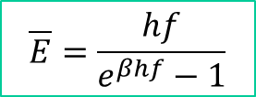
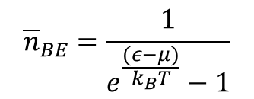
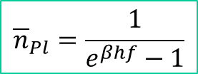
Black Body Radiation cont.
Quantum Considerations
The energy of a harmonic Oscillator is quantized, $E_{n}=0, hf, 2hf, 3hf, ⋯$
Using Boltzmann statistics, the partition function
$$Z=1+e^{−hfβ}+e^{−2hfβ}+⋯$$
➔ $Z=\frac{1}{1−e^{−βhf}}$
$\overline{E}=−\frac{1}{Z}\frac{∂Z}{∂β}$ ➔
$$\overline{E}=\frac{hf}{e^{βhf}−1}$$
Since E is in the units of hf,
We can say $\overline{E}=\left(Average \# of units\right)×hf=\overline{n}hf$
Therefore, $\overline{n}hf=\frac{hf}{e^{βhf}−1}$ ➔
$\overline{n}=\frac{1}{e^{βhf}−1}$ OR
$${\overline{n}}_{Pl}=\frac{1}{e^{βhf}−1}$$
Compare it with Bose-Einstein distribution
Planck’s distribution
$${\overline{n}}_{BE}=\frac{1}{e^{\frac{(ε−μ)}{k_{B}T}}−1}$$
Average number of photons coming out of an oscillator
Same if $ε=hf \& μ=0$
Photons are Bosons with $μ=0$

Slide 12
Black Body Radiation cont.
$${\overline{n}}_{Pl}=\frac{1}{e^{βhf}−1}$$
Short wavelength or high frequency
$$hf≫k_{B}T (or \frac{1}{β})$$
➔ $e^{βhf}≫1$
Hence, ${\overline{n}}_{Pl}≈e^{−βhf}=e^{−\frac{hc}{λ}β}$
When $λ$ is small, ${\overline{n}}_{Pl}→0$
We say shorter wavelength photons (UV photons) are frozen out
${\overline{n}}_{Pl}$ tells us number of photons in single mode (single-particle energy state)
Total Number of photons in a box (or cavity)
$$N=2\sum_{{n_{x}, n_{y}, n}_{z}}{{\overline{n}}_{Pl}(ε)}$$
Since photons have 2 states of polarization (being transverse waves)
To find $ε_{n}$, consider 1-D box of length L (standing waves)
$ε_{n}=\frac{hc}{λ_{n}}$, while $λ_{n}=\frac{2L}{n}$ ➔ $ε_{n}=\frac{nhc}{2L}$
$$N=2\sum_{{n_{x}, n_{y}, n}_{z}}{\frac{1}{e^{βε_{n}}−1}}$$

Slide 13
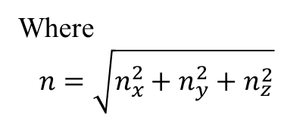
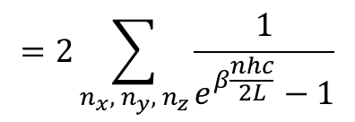
In 3-D, $ε_{n}=\frac{hc}{2L}\sqrt{n_{x}^{2}+n_{y}^{2}+n_{z}^{2}}$
Black Body Radiation cont.
$$N=2\sum_{{n_{x}, n_{y}, n}_{z}}{\frac{1}{e^{βε_{n}}−1}}$$
$$=2\sum_{{n_{x}, n_{y}, n}_{z}}{\frac{1}{e^{β\frac{nhc}{2L}}−1}}$$
Where
$$n=\sqrt{n_{x}^{2}+n_{y}^{2}+n_{z}^{2}}$$
$$=2\iiint_{0 0 0}^{\frac{π}{2} \frac{π}{2} ∞}{\frac{ndθ.nsinθd∅dn}{e^{β\frac{nhc}{2L}}−1}}$$
$$N=2\iiint_{0}^{∞}{\frac{1}{e^{β\frac{nhc}{2L}}−1}dn_{x}dn_{y}dn_{z}}$$
$$=2∙\frac{π}{2}\int_{0}^{∞}{\frac{n^{2}}{e^{β\frac{nhc}{2L}}−1}dn}$$
Substituting $x=\frac{nhcβ}{2L}=ε_{n}β a$nd $L^{3}=V$
$N=8πV{\left(\frac{k_{B}T}{hc}\right)}^{3}$ $\int_{0}^{∞}{\frac{x^{2}}{e^{x}−1}dx}$
$$\int_{0}^{∞}{\frac{x^{2}}{e^{x}−1}dx} is maximum at x=2.4$$
Inside a cavity (box), number of photons are not constant – they are absorbed and reemitted ➔ $dN=0$

Slide 14
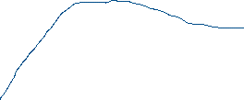
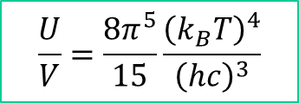
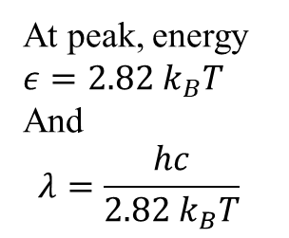
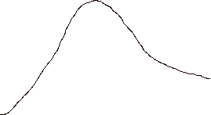

Black Body Radiation cont.
Similarly, total energy
$$U=2\sum_{{n_{x}, n_{y}, n}_{z}}{{ε_{n}\overline{n}}_{Pl}(ε)}$$
$$\frac{U}{V}=8π\frac{{\left(k_{B}T\right)}^{4}}{{\left(hc\right)}^{3}}\int_{0}^{∞}{\frac{x^{3}}{e^{x}−1}dx}$$
Energy per unit volume
Wien’s Law
$\int_{0}^{∞}{\frac{x^{3}}{e^{x}−1}dx}≈\frac{π^{4}}{15}$ and is maximum at x = 2.82
$$\frac{U}{V}=\frac{8π^{5}}{15}\frac{{\left(k_{B}T\right)}^{4}}{{\left(hc\right)}^{3}}$$
$$\frac{U}{V}$$
High T
At peak, energy $ε=2.82 k_{B}T$
And
$$λ=\frac{hc}{2.82{ k}_{B}T}$$
2.82
x

Slide 15
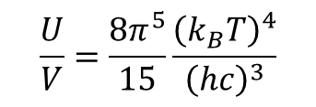
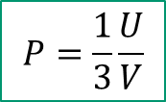
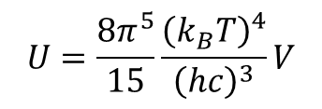
Black Body Radiation cont.
$$\frac{U}{V}=\frac{8π^{5}}{15}\frac{{\left(k_{B}T\right)}^{4}}{{\left(hc\right)}^{3}}$$
➔ $\frac{U}{V}∝T^{4}$
As heat Capacity, $C_{V}={\left(\frac{∂U}{∂T}\right)}_{V}$
We can write $U=aT^{4}$ ➔
$$C_{V}=4aT^{3}$$
$$a=\frac{8π^{5}}{15}\frac{{\left(k_{B}\right)}^{4}}{{\left(hc\right)}^{3}}V$$
We can find Entropy
$S\left(T\right)=\int_{0}^{T}{\frac{C_{V}(T^{′})}{T′}dT′}= \frac{4a}{3}T^{3}$ ➔
$S\left(T\right)=$ $\frac{32π^{5}}{45}Vk_{B}{\left(\frac{k_{B}T}{hc}\right)}^{3}$
We can also find radiation Pressure
As $P=−{\left(\frac{∂U}{∂V}\right)}_{S}$
$$U=\frac{8π^{5}}{15}\frac{{\left(k_{B}T\right)}^{4}}{{\left(hc\right)}^{3}}V$$
$$P=\frac{1}{3}\frac{U}{V}$$
You can say radiation pressure increases as T⁴

Slide 16
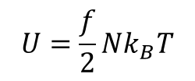
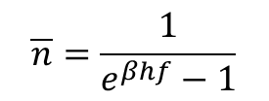
Theory of Solids
$$U=\frac{f}{2}Nk_{B}T$$
$$C_{V}={\left(\frac{∂U}{∂T}\right)}_{V}=\frac{f}{2}Nk_{B}$$
Classical model: Ideal gas model
Einstein Model:
Each atom in a solid crystal is treated as an independent 3-D harmonic oscillator
Each harmonic oscillator vibrates with frequency, f
For N atoms, there are 3N independent (distinguishable) oscillators
Distinguishable harmonic oscillator ➔ follows Bose-Einstein statistics with $μ=0$
$$\overline{n}=\frac{1}{e^{βhf}−1}$$
Planck’s distribution
Therefore, average occupancy,
$$ε=\left(\overline{n}+\frac{1}{2}\right)hf=\left(\frac{1}{e^{βhf}−1}+\frac{1}{2}\right)hf$$
Energy of each oscillator,
$$ε=\left(\frac{1}{e^{βℏω}−1}+\frac{1}{2}\right)ℏω$$
$$hf=ℏω$$
Total Energy of 3N harmonic oscillators,
$$U=3Nε$$
$C_{V}={\left(\frac{∂U}{∂T}\right)}_{V}=3N$ ${\left(\frac{∂ε}{∂T}\right)}_{V}=3N{\left(\frac{∂ε}{∂β}\right)}_{V}\left(\frac{∂β}{∂T}\right)$
$$C_{V}=3Nk_{B}{\left(\frac{ε}{k_{B}T}\right)}^{2}\frac{e^{\frac{ε}{k_{B}T}}}{{\left(e^{\frac{ε}{k_{B}T}}−1\right)}^{2}}$$

Slide 17
Theory of Solids cont.
$$C_{V}=3Nk_{B}{\left(\frac{ε}{k_{B}T}\right)}^{2}\frac{e^{\frac{ε}{k_{B}T}}}{{\left(e^{\frac{ε}{k_{B}T}}−1\right)}^{2}}$$
Einstein’s Model
For high T
➔ $e^{\frac{ε}{k_{B}T}}≪1$
$$k_{B}T≫ε$$
Taylor expansion
$$e^{\frac{ε}{k_{B}T}}≈1+\frac{ε}{k_{B}T}+⋯$$
$$C_{V}=3Nk_{B}{\left(\frac{ε}{k_{B}T}\right)}^{2}\frac{e^{\frac{ε}{k_{B}T}}}{{\left(e^{\frac{ε}{k_{B}T}}−1\right)}^{2}}≈3Nk_{B}$$
Independent of Temperature
Agrees with experimental data
For low T
$$k_{B}T≪ε$$
➔ $e^{\frac{ε}{k_{B}T}}≫1$
$C_{V}≈3Nk_{B}{\left(\frac{ε}{k_{B}T}\right)}^{2}\frac{e^{\frac{ε}{k_{B}T}}}{{\left(e^{\frac{ε}{k_{B}T}}\right)}^{2}}≈$ $3Nk_{B}{\left(\frac{ε}{k_{B}T}\right)}^{2}$ $e^{−\frac{ε}{k_{B}T}}$
Increases as Temperature increases
But experimental data shows $C_{V}∝T^{3}$
Failure of Einstein’s model
Reality is that atoms in a crystal do not vibrate independent of each other. There are modes of vibrations (oscillations)

Slide 18
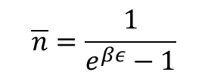
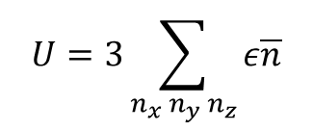
Theory of Solids cont.
Debye Model
The modes of oscillations in a solid crystal are, in many ways, similar to modes of EM field in vacuum.
Mechanical waves are called sound waves and behaves like light waves
Differences
Sound waves are slower than light.
Sound waves are longitudinally polarized while light waves are transversely polarized.
Light waves can have arbitrarily size wavelengths, while sound waves in a solid is determined by atomic spaces. $λ_{max}=2L$ (where L is minimum atomic spacing)
This puts a strict lower limit on wavelength
Energy of each oscillator, $ε=hf=\frac{hc_{s}}{λ_{n}}$
Standing waves ➔ $λ_{n}=\frac{2L}{n}$
Where c_{s} is speed of sound in the crystal.
L is length of crystal & n is magnitude of $\vec{n}$
➔ $ε=\frac{nhc_{s}}{2L}$
Similarity with EM waves suggest, BE-statistics with $μ=0$ (that is Planck’s distributions must be applied)
$$\overline{n}=\frac{1}{e^{βε}−1}$$
Total Energy of harmonic oscillators in 3-D,
$$U=3\sum_{n_{x} n_{y} n_{z}}{ε\overline{n}}$$

Slide 19
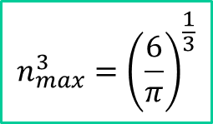
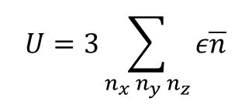
Debye Theory of Solids cont.
$$U=3\sum_{n_{x} n_{y} n_{z}}{ε\overline{n}}$$
For photons, there are infinite modes, but atomic spacing in a solid puts lower limit on wavelength (the minimum energy of sound waves is called phonons)
In 1-D each bump must at least contain one atom
Therefore, n cannot be more than number of atoms, N
In 3-D, consider a cube containing N atoms
Calculating sum is complicated
Debye’s idea was to pretend region in n-space
$$n=\sqrt{n_{x}^{2}+n_{y}^{2}+n_{z}^{2}}$$
➔ $\frac{1}{8}\left[V of sphere in n−space\right]=N$
➔ $\frac{1}{8}\frac{3}{4}πn_{max}^{3}=N$
$$n_{max}^{3}={\left(\frac{6}{π}\right)}^{\frac{1}{3}}$$
In spherical coordinates
$$U=3\int_{1}^{n_{max}}{dn}\int_{0}^{\frac{π}{2}}{dθ}\int_{0}^{\frac{π}{2}}{d∅n^{2}sinθ ε \overline{n}}$$
$$\overline{n}={\overline{n}}_{Pl}$$

Slide 20
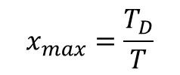
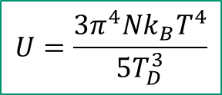
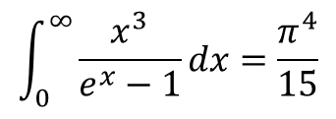
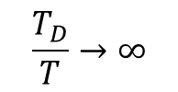
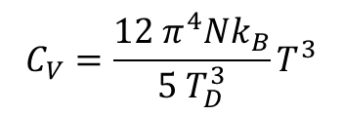
Debye Theory of Solids cont.
$$U=3\int_{1}^{n_{max}}{dn}\int_{0}^{\frac{π}{2}}{dθ}\int_{0}^{\frac{π}{2}}{d∅n^{2}sinθ ε \overline{n}}$$
$$U=3\frac{π}{2}\int_{0}^{n_{max}}{\frac{n^{2}ε}{e^{\frac{ε}{k_{B}T}}−1}dn}$$
0
Where $ε=\frac{nhc_{s}}{2L}$
$$U=3\frac{π}{2}\int_{0}^{n_{max}}{\frac{{hc_{s} n}^{3}}{{2L[e}^{\frac{hc_{s}}{{2Lk}_{B}T}}−1]}dn}$$
Assuming $x=\frac{hc_{s}n}{2Lk_{B}T}$
➔ $x_{max}=\frac{hc_{s}}{2Lk_{B}T}n_{max}=\frac{hc_{s}}{2k_{B}T}{\left(\frac{6N}{πV}\right)}^{\frac{1}{3}}$
$$U=\frac{9Nk_{B}T^{4}}{T_{D}^{3}}\int_{0}^{\frac{T_{D}}{T}}{\frac{x^{3}}{e^{x}−1}dx}$$
$$x_{max}=\frac{T_{D}}{T}$$
where $T_{D}=\frac{hc_{s}}{2k_{B}}{\left(\frac{6N}{πV}\right)}^{\frac{1}{3}}$
$$\frac{T_{D}}{T}→∞$$
$$\int_{0}^{∞}{\frac{x^{3}}{e^{x}−1}dx=\frac{π^{4}}{15}}$$
$$U=\frac{3π^{4}Nk_{B}T^{4}}{5T_{D}^{3}}$$
When $T≪T_{D}$
Low Temperature range
$$C_{V}=\frac{12 π^{4}Nk_{B}}{5{ T}_{D}^{3}}T^{3}$$
And $C_{V}={\left(\frac{∂U}{∂T}\right)}_{V}$
$$C_{V}∝T^{3}$$
In low Temp range
This agrees with experimental data
Heat capacity has contribution from electrons and lattice vibrations
$$C_{V}\left(T\right)=AT+BT^{3}$$

Slide 21
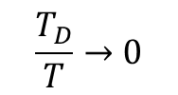
Debye Theory of Solids cont.
$$T≫T_{D}$$
$$\frac{T_{D}}{T}→0$$
What about high temperature range?
Since $x=\frac{n{hc}_{s}}{2Lk_{B}T}$
As $T→large, x→small$
$e^{x}≈1+x+⋯$ (Taylor expansion)
$\int_{0}^{\frac{T_{D}}{T}}{\frac{x^{3}}{e^{x}−1}dx≈}$ $\int_{0}^{\frac{T_{D}}{T}}{\frac{x^{3}}{x}dx}=\int_{0}^{\frac{T_{D}}{T}}{x^{2}dx=\frac{1}{3}{\left(\frac{T_{D}}{T}\right)}^{3}}$
Now
$$U=\frac{9Nk_{B}T^{4}}{T_{D}^{3}}\int_{0}^{\frac{T_{D}}{T}}{\frac{x^{3}}{e^{x}−1}dx}$$
$U=\frac{9Nk_{B}T^{4}}{T_{D}^{3}}$ $\frac{1}{3}{\left(\frac{T_{D}}{T}\right)}^{3}$
$$U=3Nk_{B}T$$
And $C_{V}={\left(\frac{∂U}{∂T}\right)}_{V}$
Independent of T in high temperature range
$$C_{V}=3Nk_{B}$$
In high temperature Debye model agrees with Einstein model
Low Temperature,
$$T≪T_{D}$$
High Temperature,
$$T≫T_{D}$$
Debye model of solid is in complete agreement with experimental data
$$C_{V}∝T^{3}$$
$C_{V}$is independent of T
Debye Temperature, T_{D} for
Lead 88 K
Diamond 1860 K

Slide 22
Chapter 7: Practice Problems
7.9, 7.11, 7.13, 7.20, 7.25, 7.26 (a, b), 7.44 (a), 7.45, 7.46 (a, b, c), and 7.58.
Assignment# 10
7.6, 7.14, 7.16, 7.18, and 7.19
Due Friday, 4/29/2022
Exam-3, Monday, May 2nd

